Slide 1


Markov Decision Processes for Hybrid Probabilistic Hierarchical Planning
Presentation by Hatem Htira
Notes:
Hello everyone , i m going to speak today about project chimp and how i extended the hybrid planner with spatial solver

Slide 2
Outline
Background
HTN
CHIMP
Spatial Solver
Solution
The Future Improvement and Conclusion
Operators & Methods
Evaluation
Improving The Spatial Solver Efficiency
Meta-CSP
Limitations
Conversion
Notes:
First of all , we hv short overview of the general approach of HTN and meta-CSP
Then i will introduceCHIMP,, and here i will tackle one of limits which the absence of spatial reasoner,
And then other solution to implement spatial solver
And in end we will finish with introducing some possible improvement to CHIMP and introduction

Slide 3
Hierarchical task network (HTN)
Hierarchical decomposition of plans
Initial plan describes high-level actions
Refine plans using action decompositions
Instead of detecting and cutting unpromising nodes
Process continues until the agent reaches primitive actions
HTN decompose into:
Compound tasks are tasks that can be decomposed into simpler tasks, implemented using methods
Primitive tasks are achieved by actions
Notes:
Let’s formalize it :
Different level and every high level will be described with sub tasks,

Slide 4
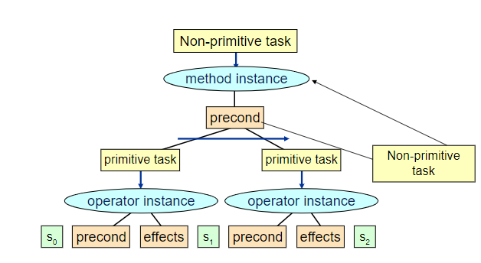
Decomposition
Compound tasks can be decomposed into simpler tasks
Primitive tasks are achieved by actions
Image 1: HTN decomposition
Notes:
➔HTN methods are only applierd when the preconditions are satisfied
Example : go_home ➔ by taxi or by car

Slide 5
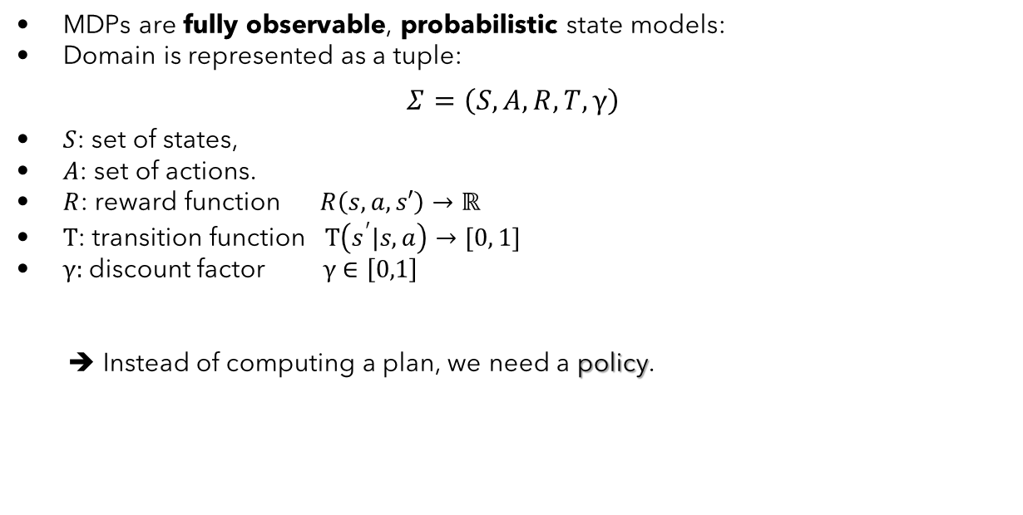
Markov Decision Processes (MDPs)
MDPs are fully observable, probabilistic state models:
Domain is represented as a tuple:
$$Σ=\left(S,A,R,T,γ\right)$$
$S$: set of states,
$A$: set of actions.
$R$: reward function $R\left(s,a,s′\right)→ℝ$
$T$: transition function $T\left(s^{′}|s,a\right)→[0, 1]$
$γ:$discount factor $γ∈\left[0,1\right]$
➔ Instead of computing a plan, we need a policy.
Notes:
Actions cause stochastic transitions. • Actions have costs/rewards.
initial state is known and fully observable ,
and actions are stochastic
describing the reward that the agent receives when it performs action a in state s and ends up in state s

Slide 6
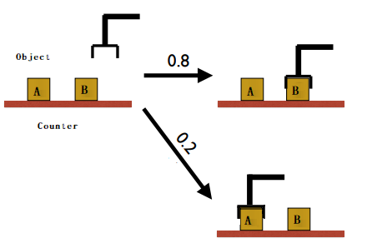
Example
Notes:
0.8 probability to reach its intended effect
0.2 probability to pick up the wrong object

Slide 7
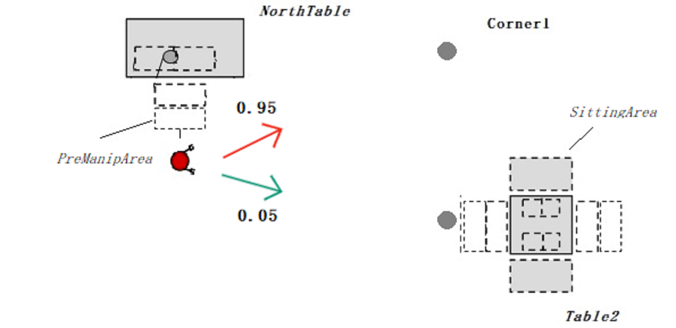
Example
Notes:
0.95 probability to reach its intended effect
0.05 probability to move at right angles of the intended direction

Slide 8
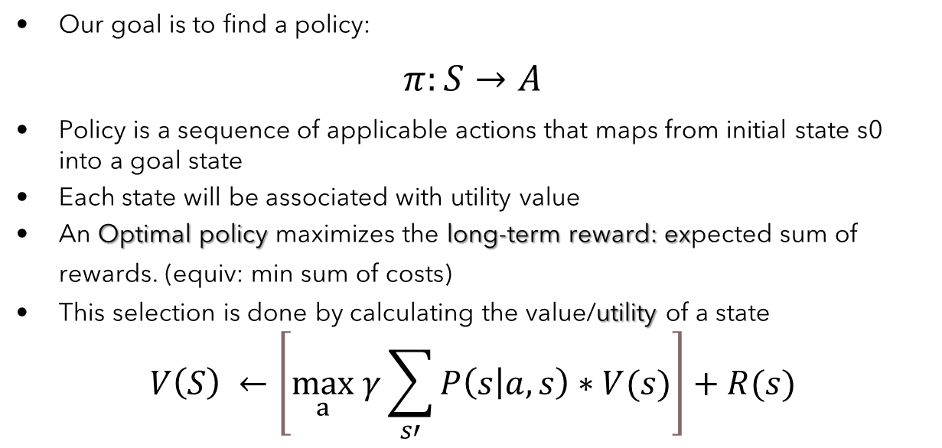
MDPs
Our goal is to find a policy:
$$π:S→A$$
Policy is a sequence of applicable actions that maps from initial state s0 into a goal state
Each state will be associated with utility value
An Optimal policy maximizes the long-term reward: expected sum of rewards. (equiv: min sum of costs)
This selection is done by calculating the value/utility of a state
$$V\left(S\right) ←\left[\max_{a} γ\sum_{s′}{P\left(s | a,s\right)∗V(s)}\right]+R(s)$$
Notes:
Policy generally specifies what the agent should do for any state
If this mapping selects the action that leads to the long-term maximum reward, then the policy is optimal

Slide 9
Back to CHIMP (Conflict-driven Hierarchical Meta-CSP Planner)
HTN planner with hybrid reasoning
Overcome the large hybrid search by extending it with hierarchical task decomposition strategy
Combine causal knowledge, temporal knowledge and resource
A CSP-style backtracking search is used to find a temporally and symbolically consistent plan
➔ Note that CHIMP description does not contain the structure of MDP
➔ Assumed closed world environment (Predictable world)
Notes:
initial state is known and fully observable ,
and actions are deterministic or(predictable)
Hybrid planning will be formulated as meta-csp
The hybrid requirement will be represented as Constraint Satisfaction Problem (CSP). A constraint network consists of a finite setof variables, a set of domains of these variables and a set of constraints,
Global consistency means we need to hv consistency in every knowledge aspect ( temporal, spatial ,,,)
We need to combine the structure and probabilistic planning➔in details we extend the chimp description with mdp structure

Slide 10
CHALLENGES & LIMITATIONS
Does not model Uncertainty (no probabilities).
Does not consider a more general models.
Solution:
➔ Combine the existing HTN structure with an MDP solver.
Issues raised:
How can we represent reward and action behaviors in the hierarchical planning (CHIMP)?
How to get all the possible states from HTN?
Why can’t we reject HTN altogether and only use MDPs?
Notes:
How can HTNs be modelled as MDPs?

Slide 11
CHALLENGES & LIMITATIONS
Hierarchical Task Network (CHIMP)
States are not enumerated exhaustively
State consists of properties of the environment
Each action modifies properties of the environment
Set of actions induces a smaller state space
Markov Decision Process
MDP domain explicitly enumerates all relevant states
Implicitly represent the same properties expressed in HTN state
MDP solver must consult the entire state space
Astronomically large: difficult to solve if the problem is very complex (hundreds of state variables)
Notes:
The planning is done offline based on the assumption that all the actions are deterministic
Spoon inside a cup

Slide 12
From HTN to MDP
Expansion
Generate States
Generate transition functions
Generate reward function

Slide 13
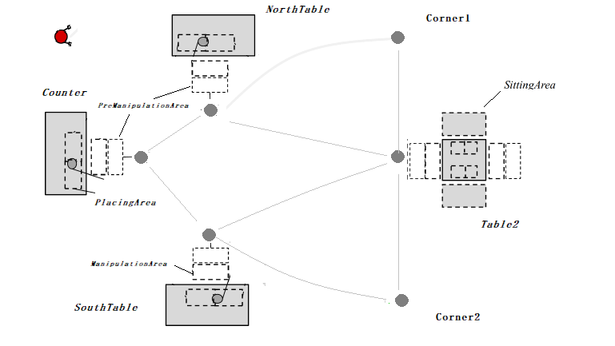
From HTN to MDP (Expansion)
The idea here is to fully expand the HTN domain into graph:
Defined by tasks (vertices) and ordering constraints (edges)
Each primitive task induces a state
ToADD

Slide 14
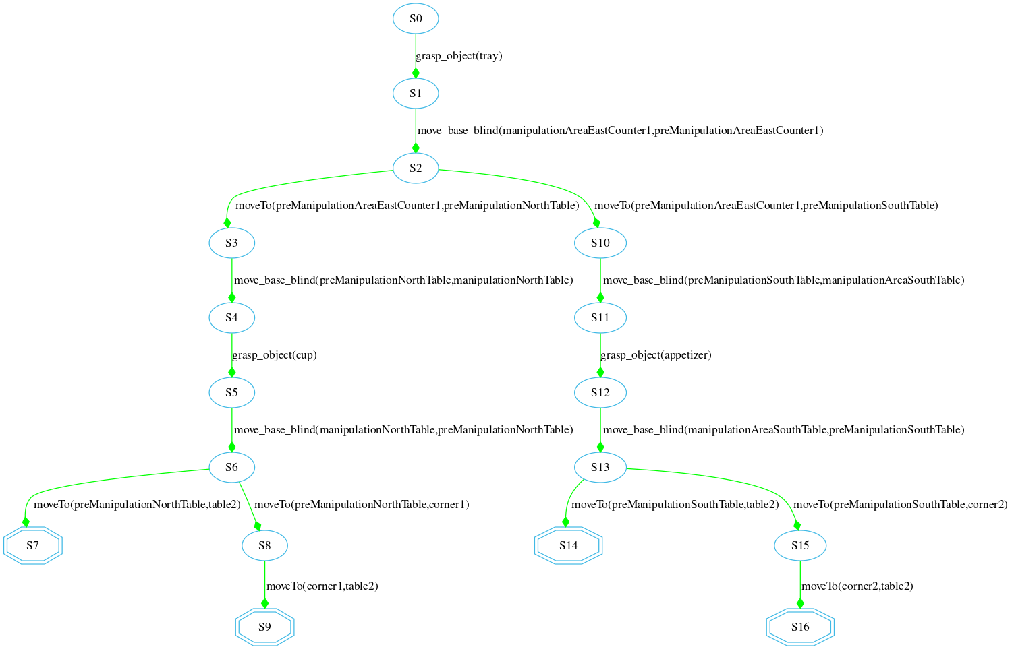
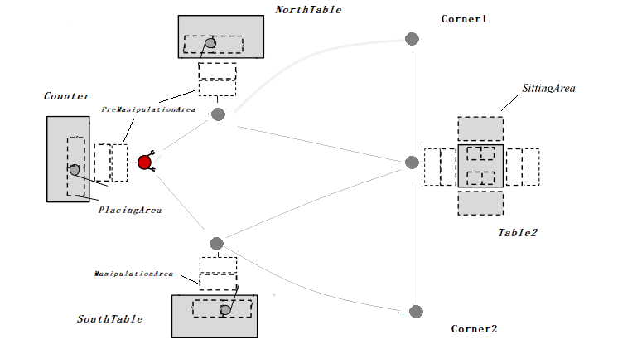
Expansion Examples: drive_robot() (from Counter)
Decompose task through methods in the domain until primitive tasks are reached

Slide 15
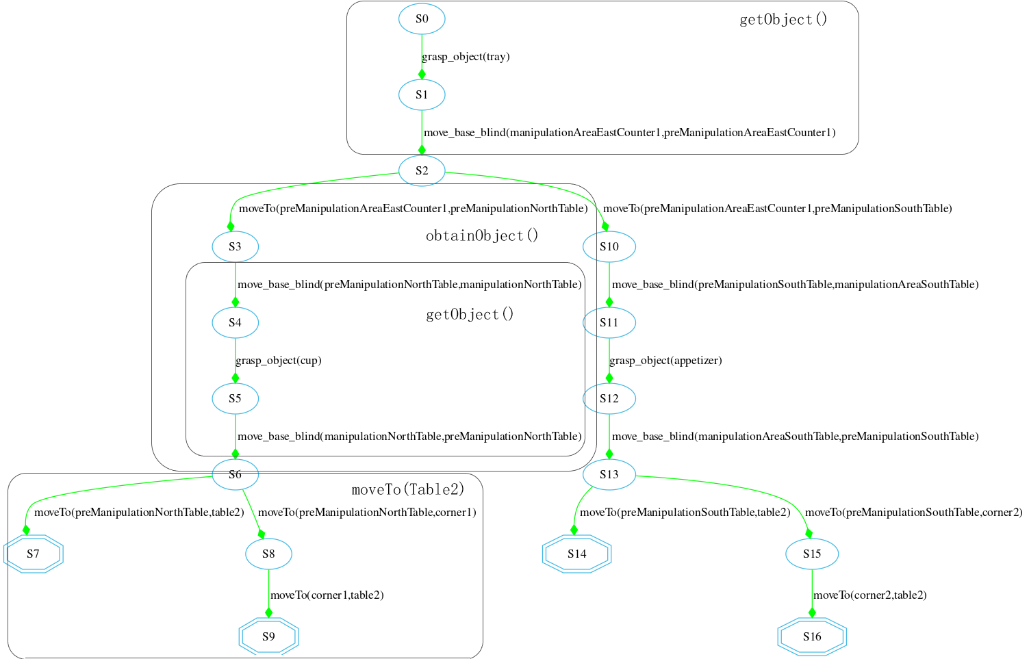
Notes:
All the methods will be decomposed until only primitive éléments are left

Slide 16
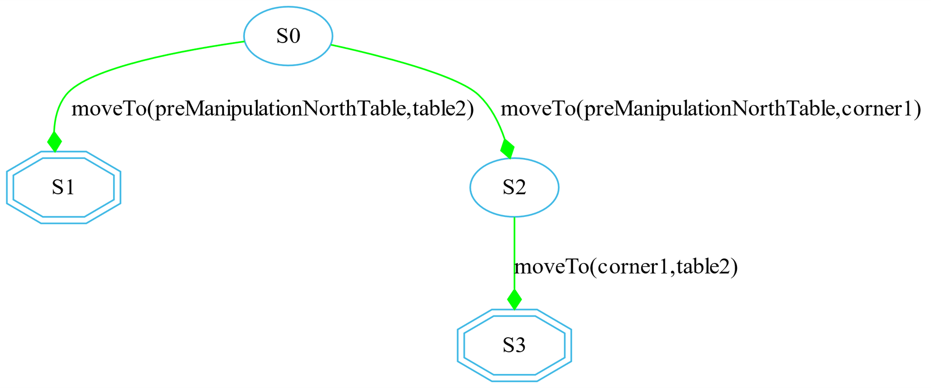
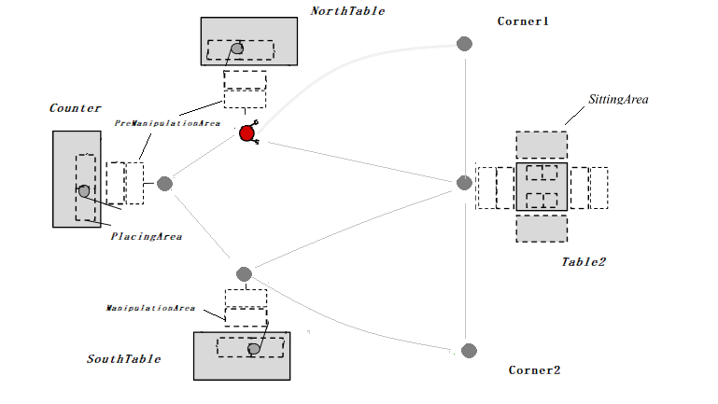
Expansion Examples: drive_robot() (from northTable)
The HTN decompositions depends also on the initial problem description

Slide 17
States Génération
State-Spaces comes from the reachable primitive tasks in the fully expanded HTN
All expanded HTN states will be used as input for MDP solver
Each primitive task in the fully decomposed HTN is considered to represent the state achieved immediately after executing the action associated with it
Algorithm must detect the overlapping states (for the transition functions) :
Partition them so that there is no ambiguity over the current state for MDP
Notes:
For mdp consists of non-overlapping states ,
in some scenarios we could have states with the same axioms or features , as an abstract example,

Slide 18
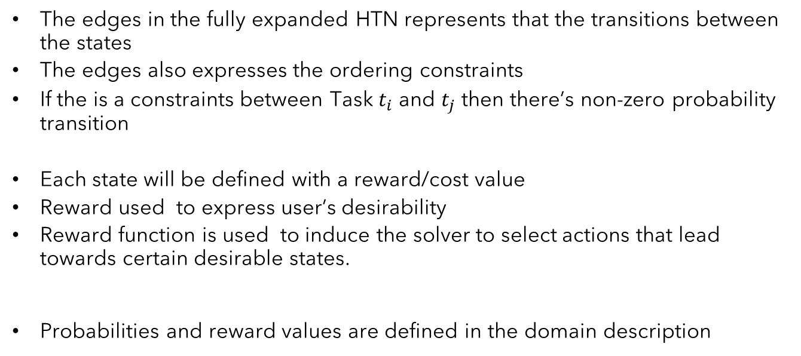
Transition Functions / Reward Génération
The edges in the fully expanded HTN represents that the transitions between the states
The edges also expresses the ordering constraints
If the is a constraints between Task $t_{i}$ and $t_{j}$ then there’s non-zero probability transition
Each state will be defined with a reward/cost value
Reward used to express user’s desirability
Reward function is used to induce the solver to select actions that lead towards certain desirable states.
Probabilities and reward values are defined in the domain description
Notes:
Reward function in an MDP is to induce the solver to select actions that lead an agent towards certain desirable states.

Slide 19
Operator (CHIMP)
(:operator
(Head !pick_up_object(?obj ?arm))
(Pre p1 On(?obj ?fromArea))
(Pre p2 RobotAt(?mArea))
(Pre p3 Holding(?arm ?nothing))
(Del p1)
(Del p3)
(Add e1 Holding(?arm ?obj))
(Constraint During(task,p2))
(Constraint Meets(p4,e1))
(Constraint Duration[4000,INF](task))
(ResourceUsage
(Usage armManCapacity 1)))
Primitive task
Precondition
Effect
Temporal Constraints
Resource fluents
Notes:
As small demonstration
Robot should be at the table the whole time
In operator , we hv the possiblity to specifiy the duration

Slide 20
Operator (CHIMP)
(:operator
(Head !pick_up_object(?obj ?arm))
(Pre p1 On(?obj ?fromArea))
(Pre p2 RobotAt(?mArea))
(Pre p3 Holding(?arm ?nothing))
…
(Reward -0,04)
(TransitionProb 0,80)
…
(ResourceUsage
(Usage armManCapacity 1)))
Markovian inputs
Notes:
As small demonstration
Robot should be at the table the whole time
In operator , we hv the possiblity to specifiy the duration

Slide 21
The necessity of Conditional Probability
Not all states has the same reward and transition probability
Flexibility in assignment markovian parametres for each specific state and task

Slide 22
The necessity of Conditional Probability
Each primitive task has ist own transition probability,
Distinguish the possible operators through the if-statement.
// move from ?l1 to ?l2
(:operator
(Head !moveTo(?l1 ?l2))
....
(if (Values ?l2 london) (Reward 1)) // final state only reward
(if (Values ?l2 corner1) (Reward -0.06) (TransitionProb 0.7))
(else (Reward -0.04) (TransitionProb 1)) // all the other states
(ResourceUsage (Usage Money 30))
)
Comparaison between symbolic arguments
If the boolean expression evaluates to true, a reward and transition probability statements are then executed.
One summarized operator instead of operator for each path
Notes:
An updated form of IF-statements ( IF-THEN and IF-THEN-ELSE )
is implemented and can be used flexibly depending on the usage and
designer planning choice,

Slide 23
Deal with Diverse Knowledge (Hybrid Planning)
How to express hybrid knowledge in MDP solver?
The markovian parameters will be updated during the parameters generation based on the hybrid knowledge
Only if inconsistency is found
Use the conditional clauses to affect the reward in each state
Check resource availability
Apriori defined:
(ResourceUsage (Usage Money 40))
Calculated based on spatial knowledge:
( UnarySpatialFluent sp1 Size ( counter [4,4] [18,18] ))
( UnarySpatialFluent sp2 Size ( table2 [4,4] [18 ,18] ))
( UnarySpatialFluent sp3 At ( Counter [50,50] [54,54] [50,50] [68,68] ))
( UnarySpatialFluent sp4 At ( table1 [72,72] [76,76] [50,50] [68,68] ))
Notes:
Sevral aspects of hybrid reason are included in our approach
we fetch the remaining resource of the incoming state

Slide 24
Deal with Diverse Knowledge (Resource Reasoning)
Resource consistency is checked using TCSP solver
Manage numeric constraints and to detect inconsistencies effectivel
The constraint propagation will be done simultaneous during transition
probability generation
(if (IC ?Money > 50) (decrease Reward 0.02)
Picture of the north table and the two paths to do

Slide 25
Deal with Diverse Knowledge (Resource Reasoning)
(:operator
(Head !moveTo(?l1 ?l2))
(Pre p1 robotAt(?l1))
(Del p1)
(Add e1 robotAt(?l2))
(if (Values ?l2 table2) (Reward 1)) #table2 always is the final state
(if (Values ?l1 corner1) (Reward 1.2) (TransitionProb 0.9)) #
(if (Values ?l2 corner2) (Reward -0.04) (TransitionProb 0.9)) #
(else (Reward -0.04) (TransitionProb 0.7)) #
(if (IC ?Money > 10) (decrease (Reward 0.22))
(ResourceUsage
(Usage BatteryStorageCapacity 30))
)

Slide 26
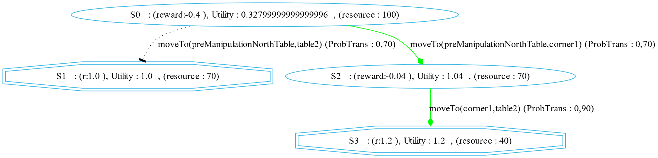
Deal with Diverse Knowledge (Resource Reasoning)
(Resource BatteryStorageCapacity 100)
*Favorise S3

Slide 27
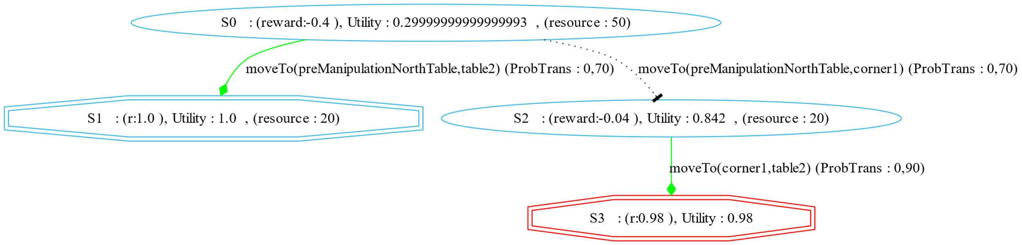
Deal with Diverse Knowledge (Resource Reasoning)
(Resource BatteryStorageCapacity 50)
*Red octagon indicates inconsistent state

Slide 28
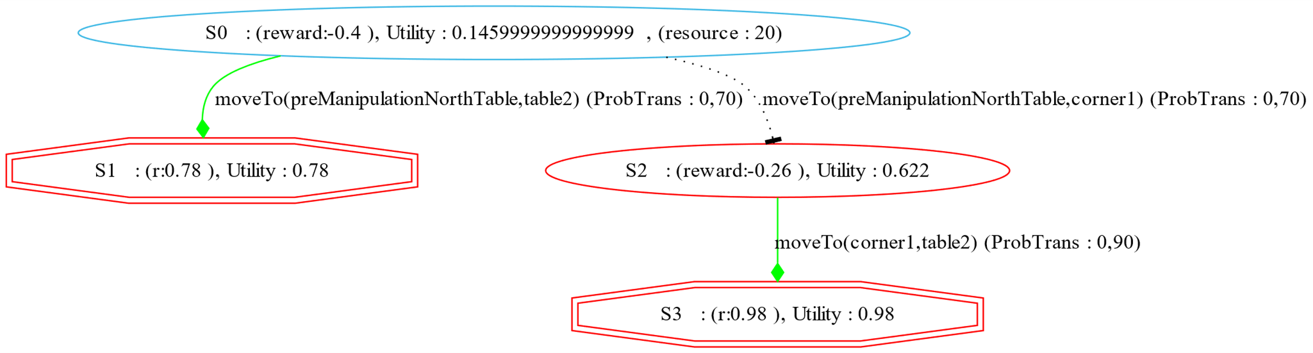
Deal with Diverse Knowledge (Resource Reasoning)
(Resource BatteryStorageCapacity 20)
*No Solution

Slide 29
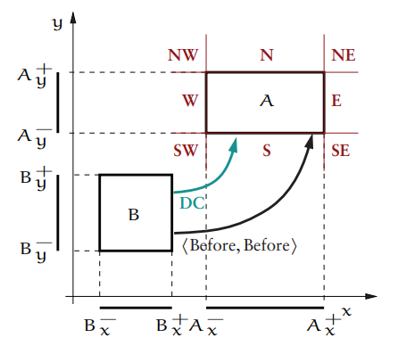
Deal with Diverse Knowledge (Spatial Reasoning)
Unary Constraints:
Size [Lx, Ux], [Ly, Uy]
At [Lx1, Ux1], [Lx2, Ux2], [Ly1, Uy1], [Ly2, Uy2]
Resource usage will be defined by spatial knowledge,
The distance between two places, will determine the resource usage,
*Implemented during the 15 ECTS research project

Slide 30
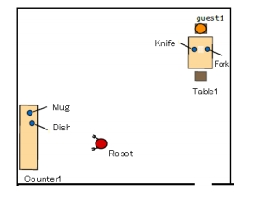
Evaluation(TODO)
Task:
serve an empty dish from counter1 to table1
Resources:
Cap(LeftArm)=1, Cap(RightArm)=1
4 possible scenarios:
Collision(Mug Dish) : Boolean
Enoughdistance(..) : Boolean
Image 4: Layout of the scenario
Notes:
Require less operators false false

Slide 31
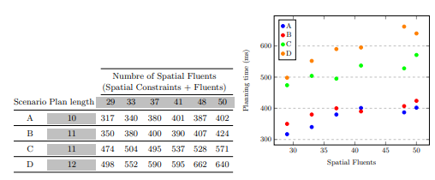
Evaluation
Image 5: Performance results
Notes:
As larger the plan ist, the longer the exécution time
--C is heavier to execute in computation level and to check the fluent function,,

Slide 32
Results
Required plan's operators to execute task C
!pick_up_object(dish1 rightArm1)([...], [...]) [[1, 1], [4001, 471988]]
!move_base_blind(preManipulationAreaEastCounter1)([...], [...])[[4002, 471989], [8002, 475989]]
!move_torso(TorsoMiddlePosture)([...], [...]) [[8003, 475990], [12003, 479992]]
!move_arms_to_carryposture(n)([...], [...]) [[8005, 475992], [12005, 479992]]
!move_base(preManipulationAreaSouthTable1)([...], [...])[[12006, 479993], [15006, 482993]]
!move_torso(TorsoUpPosture)([...], [...]) [[15007, 482994], [19007, 490995]]
!move_arm_to_side(leftArm1)([...], [...]) [[15007, 482994], [19007, 486994]]
!move_arm_to_side(rightArm1)([...], [...]) [[19008, 486995], [23008, 490995]]
!move_base_blind(manipulationAreaTable1)([...], [...]) [[23009, 490996], [27009, 494996]]
!shift_object(fork1 dish1 rightArm1)(0, 0) [[27010, 494999], [32012, 499999]].
!place_object(dish1 rightArm1 placingAreaTable1)([...], [...]) [[32013, 494997], [32020, 499999]]

Slide 33
Perspectives
Consider scenarios such populated environment or when the actions are non-deterministic
Deal with uncertainty and ensure collision-free navigation
Extend RA to greater dimensions such 3D
Adapt CHIMP to be integrated into cooperative multi-agent environments
consider a continuous learning environment
Notes:
Allow the model to learn and esnure safty through GP for example
Continous using using Reinforcement learning and maybe ensure safness using GP,,
Robot behind the counter,,s

Slide 34
Conclusion
It has required more human effort to improve its knowledge base to get better performance.
Solving linear programs such as TCSP can be solved in polynomial time
Such calculations are computationally heavy.
There is a large room for improvement
This model provides rich and flexible semantics for encoding the spatial aspect
Notes:
To sum up,
using unary and binary constraints combined with spatial uents function
to dene an additional expressive form of knowledge

Slide 35

Thank You For Your Attention.

Slide 36
Literature
Meneguzzi, F. e. (2011). An approach to generate MDPs using HTN representations." Decision Making in Partially Observable, Uncertain Worlds: Exploring Insights from Multiple Communities,. Barcelona, Spain.
Stock, S. (2017). Hierarchische hybride Planung für mobile Roboter.

